Slide 1

Feature selection for svms
via Mixed Integer Linear Programming
Maldonado, Pérez, Weber, Labbé

Slide 2

Overall structure
Feature selection for SVMs

Slide 3

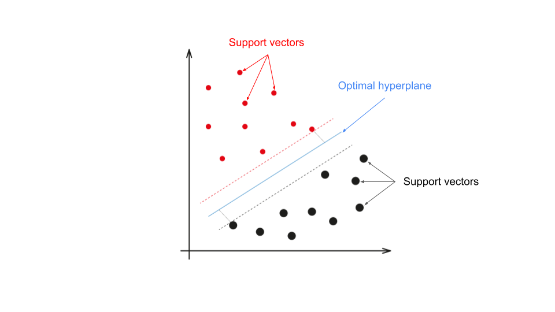
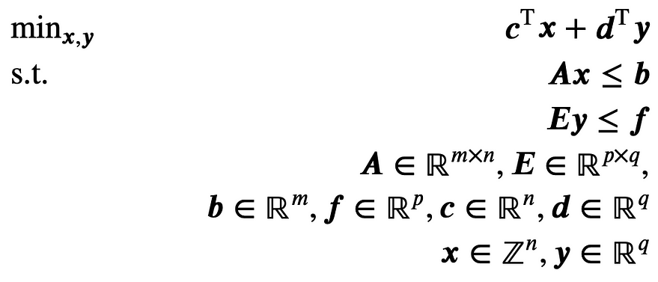
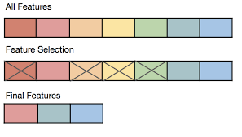
Overall structure
Formulations
SVM
Feature Selection
MILP
Motivation
Existing methods
Proposed methods
Results

Slide 4
Motivation
Feature selection for SVMs

Slide 5
Motivation
SVMs provide several advantages
Feature selection is an important topic within modeling
Selection of the best subset is considered NP-hard
Several previous approaches already perform well, but none of them utilizes MILP

Slide 6
Method
Feature selection for SVMs

Slide 7
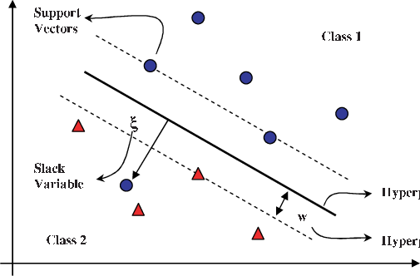
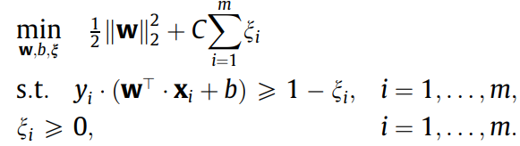
Support vector machine

Slide 8
Embedded Methods
2 tasks at hand:
Training the model
Selecting the optimal set of features
Embedded method = doing the 2 simultaneously
Computationally less expensive
Usually done by forcing selection into the optimization part

Slide 9
Overview of all Methods
Existing methods
Proposed methods
l1-SVM: classic SVM + LASSO penatly
LP-SVM: classic SVM + linear programming
l2-SVM
Fisher + SVM
RFE-SVM
l0-SVM
MILP1: l₁-SVM adapted to Mixed Integer Programming formulations
MILP2: LP-SVM adapted to Mixed Integer Programming formulations

Slide 10
Summary
Feature selection for SVMs

Slide 11
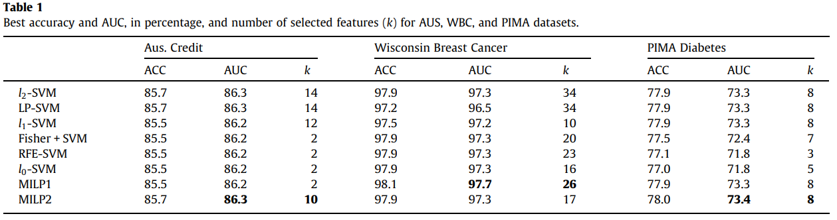
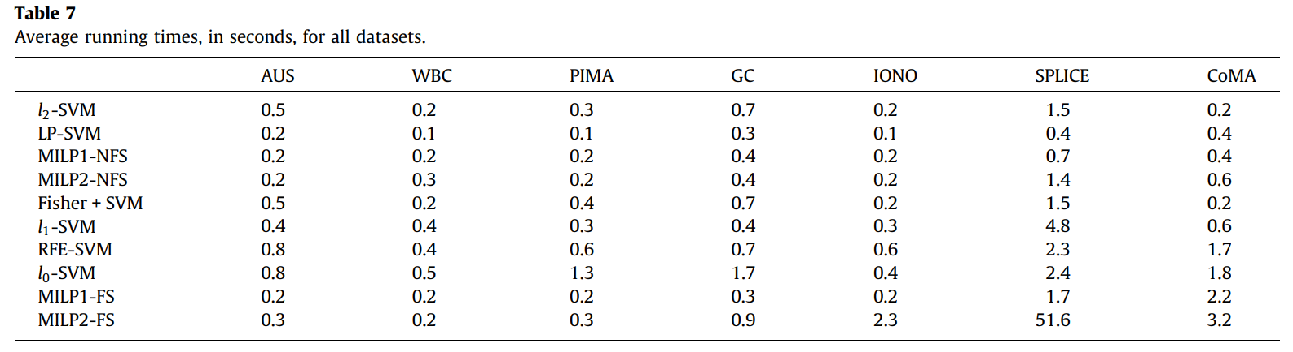
Summary

Slide 12
THANK YOU
Botond Kovács

